Slide 1
Lesson 15
How to create stored procedures and functions
Lecture adapted from Murach’s MySQL Textbooks

Slide 2
Objectives
Applied
Create stored procedures and functions using any of the features presented in this chapter.
Code CALL statements that run stored procedures.
Code SQL statements that use functions.
Use MySQL Workbench to work with procedures and functions.
Knowledge
Describe the basic process for validating data within a stored procedure or function.
Describe the use of dynamic SQL.

Slide 3
The CREATE PROCEDURE statement
CREATE PROCEDURE procedure_name
(
[parameter_name_1 data_type]
[, parameter_name_2 data_type]...
)
sql_block

Slide 4
A stored procedure that updates a table
DELIMITER //
CREATE PROCEDURE update_invoices_credit_total
(
invoice_id_param INT,
credit_total_param DECIMAL(9,2)
)
BEGIN
DECLARE sql_error TINYINT DEFAULT FALSE;
DECLARE CONTINUE HANDLER FOR SQLEXCEPTION
SET sql_error = TRUE;
START TRANSACTION;
UPDATE invoices
SET credit_total = credit_total_param
WHERE invoice_id = invoice_id_param;

Slide 5
A stored procedure that updates a table (cont.)
IF sql_error = FALSE THEN
COMMIT;
ELSE
ROLLBACK;
END IF;
END//
A statement that calls the stored procedure
CALL update_invoices_credit_total(56, 300);

Slide 6
The syntax for declaring parameters
[IN|OUT|INOUT] parameter_name data_type
A stored procedure that uses parameters
DELIMITER //
CREATE PROCEDURE update_invoices_credit_total
(
IN invoice_id_param INT,
IN credit_total_param DECIMAL(9,2),
OUT update_count INT
)
BEGIN
DECLARE sql_error TINYINT DEFAULT FALSE;
DECLARE CONTINUE HANDLER FOR SQLEXCEPTION
SET sql_error = TRUE;
START TRANSACTION;

Slide 7
A stored procedure that uses parameters (cont.)
UPDATE invoices
SET credit_total = credit_total_param
WHERE invoice_id = invoice_id_param;
IF sql_error = FALSE THEN
SET update_count = 1;
COMMIT;
ELSE
SET update_count = 0;
ROLLBACK;
END IF;
END//

Slide 8
A script that calls the stored procedure
CALL update_invoices_credit_total(56, 200, @row_count);
SELECT CONCAT('row_count: ', @row_count) AS update_count;

Slide 9
A procedure that provides a default parameter value
DELIMITER //
CREATE PROCEDURE update_invoices_credit_total
(
invoice_id_param INT,
credit_total_param DECIMAL(9,2)
)
BEGIN
DECLARE sql_error TINYINT DEFAULT FALSE;
DECLARE CONTINUE HANDLER FOR SQLEXCEPTION
SET sql_error = TRUE;
-- Set default values for NULL values
IF credit_total_param IS NULL THEN
SET credit_total_param = 100;
END IF;

Slide 10
A procedure that provides a default parameter value (continued)
START TRANSACTION;
UPDATE invoices
SET credit_total = credit_total_param
WHERE invoice_id = invoice_id_param;
IF sql_error = FALSE THEN
COMMIT;
ELSE
ROLLBACK;
END IF;
END//
A statement that calls the stored procedure
CALL update_invoices_credit_total(56, 200);
Another statement that calls the stored procedure
CALL update_invoices_credit_total(56, NULL);

Slide 11
The syntax of the SIGNAL statement
SIGNAL SQLSTATE [VALUE] sqlstate_value
[SET MESSAGE_TEXT = message
[, MYSQL_ERRNO = mysql_error_number]]
A procedure that raises a predefined exception
DELIMITER //
CREATE PROCEDURE update_invoices_credit_total
(
invoice_id_param INT,
credit_total_param DECIMAL(9,2)
)
BEGIN
-- Validate paramater values
IF credit_total_param < 0 THEN
SIGNAL SQLSTATE '22003'
SET MESSAGE_TEXT =
'The credit_total column must ‘ +
‘be greater than or equal to 0.',
MYSQL_ERRNO = 1264;

Slide 12
A procedure that raises a predefined exception (continued)
ELSEIF credit_total_param >= 1000 THEN
SIGNAL SQLSTATE '22003'
SET MESSAGE_TEXT =
'The credit_total column must be less than 1000.',
MYSQL_ERRNO = 1264;
END IF;
-- Set default values for parameters
IF credit_total_param IS NULL THEN
SET credit_total_param = 100;
END IF;
UPDATE invoices
SET credit_total = credit_total_param
WHERE invoice_id = invoice_id_param;
END//

Slide 13
A statement that calls the procedure
CALL update_invoices_credit_total(56, -100);
The response from the system
Error Code: 1264.
The credit_total column must be greater than or equal to 0.

Slide 14
A procedure that validates data (part 1)
DELIMITER //
CREATE PROCEDURE insert_invoice
(
vendor_id_param INT,
invoice_number_param VARCHAR(50),
invoice_date_param DATE,
invoice_total_param DECIMAL(9,2),
terms_id_param INT,
invoice_due_date_param DATE
)
BEGIN
DECLARE terms_id_var INT;
DECLARE invoice_due_date_var DATE;
DECLARE terms_due_days_var INT;

Slide 15
A procedure that validates data (part 2)
-- Validate paramater values
IF invoice_total_param < 0 THEN
SIGNAL SQLSTATE '22003'
SET MESSAGE_TEXT =
'The invoice_total column must be a positive number.',
MYSQL_ERRNO = 1264;
ELSEIF invoice_total_param >= 1000000 THEN
SIGNAL SQLSTATE '22003'
SET MESSAGE_TEXT =
'The invoice_total column must be less than 1,000,000.',
MYSQL_ERRNO = 1264;
END IF;
-- Set default values for parameters
IF terms_id_param IS NULL THEN
SELECT default_terms_id INTO terms_id_var
FROM vendors WHERE vendor_id = vendor_id_param;
ELSE
SET terms_id_var = terms_id_param;
END IF;

Slide 16
A procedure that validates data (part 3)
IF invoice_due_date_param IS NULL THEN
SELECT terms_due_days INTO terms_due_days_var
FROM terms WHERE terms_id = terms_id_var;
SELECT DATE_ADD(invoice_date_param,
INTERVAL terms_due_days_var DAY)
INTO invoice_due_date_var;
ELSE
SET invoice_due_date_var = invoice_due_date_param;
END IF;
INSERT INTO invoices
(vendor_id, invoice_number, invoice_date,
invoice_total, terms_id, invoice_due_date)
VALUES (vendor_id_param, invoice_number_param, invoice_date_param, invoice_total_param, terms_id_var, invoice_due_date_var);
END//

Slide 17
Two statements that call the stored procedure
CALL insert_invoice(34, 'ZXA-080', '2018-01-18',
14092.59, 3, '2015-03-18');
CALL insert_invoice(34, 'ZXA-082', '2018-01-18',
14092.59, NULL, NULL);
The message for a successful insert
1 row(s) affected

Slide 18
A statement that raises an error
CALL insert_invoice(34, 'ZXA-080', '2015-01-18',
-14092.59, NULL, NULL);
The message when a validation error occurs
Error Code: 1264.
The invoice_total column must be a positive number.

Slide 19
The syntax for setting a user variable
SET @variable_name = expression
Two stored procedures that use the same variable
DELIMITER //
CREATE PROCEDURE set_global_count
(
count_var INT
)
BEGIN
SET @count = count_var;
END//
CREATE PROCEDURE increment_global_count()
BEGIN
SET @count = @count + 1;
END//

Slide 20
Two statements that call these stored procedures
CALL set_global_count(100);
CALL increment_global_count();
A SELECT statement that directly accesses the variable
SELECT @count AS count_var

Slide 21
A stored procedure that uses dynamic SQL
DELIMITER //
CREATE PROCEDURE select_invoices
(
min_invoice_date_param DATE,
min_invoice_total_param DECIMAL(9,2)
)
BEGIN
DECLARE select_clause VARCHAR(200);
DECLARE where_clause VARCHAR(200);
SET select_clause = "SELECT invoice_id,
invoice_number, invoice_date,
invoice_total FROM invoices ";
SET where_clause = "WHERE ";
IF min_invoice_date_param IS NOT NULL THEN
SET where_clause = CONCAT(where_clause,
" invoice_date > '",
min_invoice_date_param, "'");
END IF;

Slide 22
A stored procedure that uses dynamic SQL (cont.)
IF min_invoice_total_param IS NOT NULL THEN
IF where_clause != "WHERE " THEN
SET where_clause = CONCAT(where_clause, "AND ");
END IF;
SET where_clause = CONCAT(where_clause,
"invoice_total > ", min_invoice_total_param);
END IF;
IF where_clause = "WHERE " THEN
SET @dynamic_sql = select_clause;
ELSE
SET @dynamic_sql = CONCAT(select_clause, where_clause);
END IF;
PREPARE select_invoices_statement
FROM @dynamic_sql;
EXECUTE select_invoices_statement;
DEALLOCATE PREPARE select_invoices_statement;
END//

Slide 23
A @dynamic_sql variable at runtime with parameters inserted
SELECT invoice_id, invoice_number, invoice_date,
invoice_total
FROM invoices
WHERE invoice_date > '2017-07-25' AND invoice_total > 100

Slide 24
The syntax of the DROP PROCEDURE statement
DROP PROCEDURE [IF EXISTS] procedure_name
A statement that creates a stored procedure
DELIMITER //
CREATE PROCEDURE clear_invoices_credit_total
(
invoice_id_param INT
)
BEGIN
UPDATE invoices
SET credit_total = 0
WHERE invoice_id = invoice_id_param;
END//

Slide 25
A statement that drops the stored procedure
DROP PROCEDURE clear_invoices_credit_total
A statement that drops the stored procedure only if it exists
DROP PROCEDURE IF EXISTS clear_invoices_credit_total

Slide 27
Creating Functions

Slide 28
The syntax of the CREATE FUNCTION statement
CREATE FUNCTION function_name
(
[parameter_name_1 data_type]
[, parameter_name_2 data_type]...
)
RETURNS data_type
[NOT] DETERMINISTIC
{CONTAINS SQL|NO SQL|READS SQL DATA|MODIFIES SQL DATA}
sql_block

Slide 29
A function that returns the vendor ID
DELIMITER //
CREATE FUNCTION get_vendor_id
(
vendor_name_param VARCHAR(50)
)
RETURNS INT
DETERMINISTIC READS SQL DATA
BEGIN
DECLARE vendor_id_var INT;
SELECT vendor_id
INTO vendor_id_var
FROM vendors
WHERE vendor_name = vendor_name_param;
RETURN(vendor_id_var);
END//

Slide 30
A SELECT statement that uses the function
SELECT invoice_number, invoice_total
FROM invoices
WHERE vendor_id = get_vendor_id('IBM');

Slide 31
Some of the characteristics for a MySQL function
DETERMINISTIC
NOT DETERMINISTIC
READS SQL DATA
MODIFIES SQL DATA
CONTAINS SQL
NO SQL
*Note
Because binary logging is enabled by default with MySQL 8.0, each function must include the DETERMINISTIC, NO SQL, or READS SQL DATA characteristic.

Slide 32
A function that gets a random number
DELIMITER //
CREATE FUNCTION rand_int()
RETURNS INT
NOT DETERMINISTIC
NO SQL
BEGIN
RETURN ROUND(RAND() * 1000);
END//
A SELECT statement that uses the function
SELECT rand_int() AS random_number;

Slide 33
A function that calculates balance due
DELIMITER //
CREATE FUNCTION get_balance_due
(
invoice_id_param INT
)
RETURNS DECIMAL(9,2)
DETERMINISTIC READS SQL DATA
BEGIN
DECLARE balance_due_var DECIMAL(9,2);
SELECT invoice_total - payment_total - credit_total
INTO balance_due_var
FROM invoices
WHERE invoice_id = invoice_id_param;
RETURN balance_due_var;
END//

Slide 34
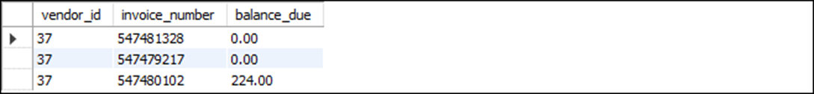
A statement that calls the get_balance_due function
SELECT vendor_id, invoice_number,
get_balance_due(invoice_id) AS balance_due
FROM invoices
WHERE vendor_id = 37
The response from the system

Slide 35
The syntax of the DROP FUNCTION statement
DROP FUNCTION [IF EXISTS] function_name
A statement that creates a function
DELIMITER //
CREATE FUNCTION get_sum_balance_due
(
vendor_id_param INT
)
RETURNS DECIMAL(9,2)
DETERMINISTIC READS SQL DATA
BEGIN
DECLARE sum_balance_due_var DECIMAL(9,2);
SELECT SUM(get_balance_due(invoice_id))
INTO sum_balance_due_var
FROM invoices
WHERE vendor_id = vendor_id_param;
RETURN sum_balance_due_var;
END//

Slide 36
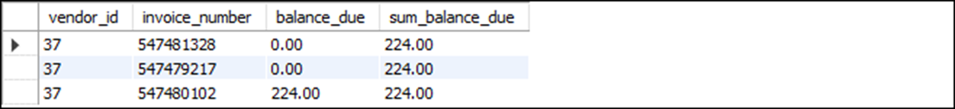
A statement that calls the get_sum_balance_due function
SELECT vendor_id, invoice_number,
get_balance_due(invoice_id) AS balance_due,
get_sum_balance_due(vendor_id) AS sum_balance_due
FROM invoices
WHERE vendor_id = 37;
The response from the system

Slide 37
A statement that drops the function
DROP FUNCTION get_sum_balance_due;
A statement that drops the function only if it exists
DROP FUNCTION IF EXISTS get_sum_balance_due;

Slide 38
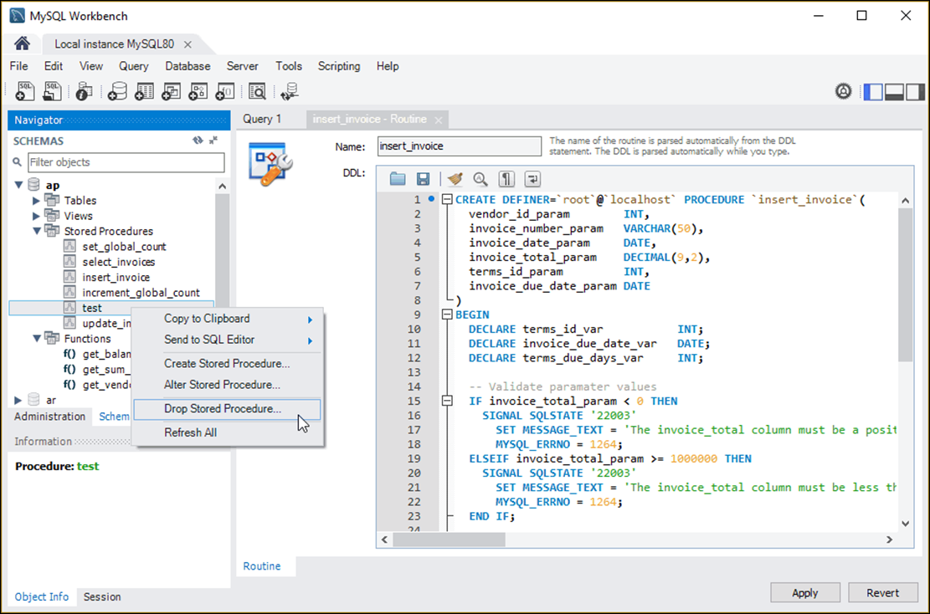
A stored procedure in MySQL Workbench

Slide 39
Operations you can perform in MySQL Workbench
View stored procedures and functions
Create a new stored procedures and functions
Drop stored procedures and functions
Display information about stored procedures using the SHOW PROCEDURE STATUS statement
Display information about functions using the SHOW FUNCTION STATUS statement

